Slide 1
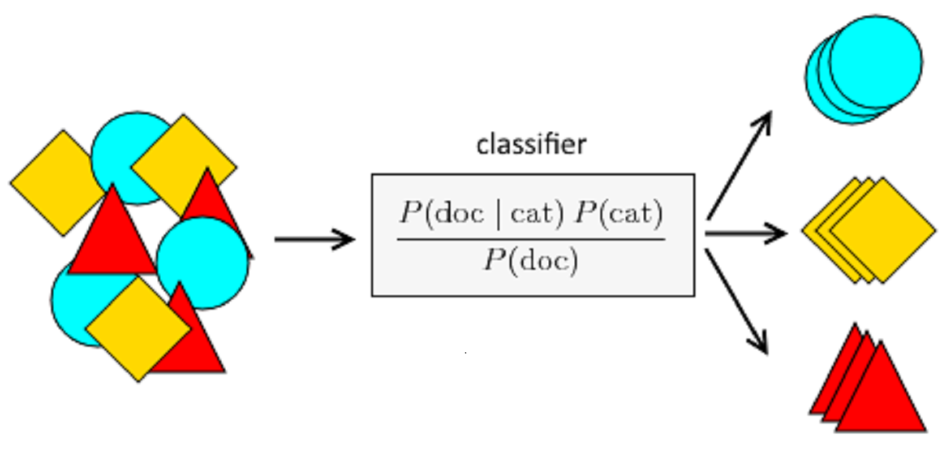
Naive Bayes Algorithm
By
Shruthi K R
Asst. Professor
Dept. of ISE

Slide 2
Outline
Background
Probability Basics
Bayes Theorem
Naïve Bayes
Example: , Stolen Car, Play Tennis
Relevant Issues
Conclusions

Slide 3

Bayesian Learning
Provides probabilistic approach to inference
Type of Probability
Marginal Probability
Joint Probability
Conditional Probability
Conditional Probability
Probability of one (or more) event given the occurrence of another event, e.g. P(A given B) or P(A | B).
P(A|B) = P(B|A) * P(A) / P(B)

Slide 4




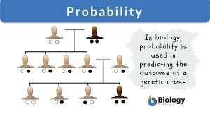
Why Probability?

Slide 5
BAYES THEOREM
Bayes Theorem is a method to determine conditional probabilities – that is, the probability of one event occurring given that another event has already occurred. Because a conditional probability includes additional conditions – in other words, more data – it can contribute to more accurate results.

Slide 6


Example
youth (18-35)
middle-aged (35-60)
seniors (60+)

Slide 7
Bayes Theorem with Example
Let us term our data X. In Bayesian terminology, X is called evidence. We have some hypothesis H, where we have some X that belongs to a certain class C.
Our goal is to determine the conditional probability of our hypothesis H given X, i.e., P(H | X).
In simple terms, by determining P(H | X), we get the probability of X belonging to class C, given X. X has attributes of age and income – let’s say, for instance, 26 years old with an income of $2000. H is our hypothesis that the customer will buy the book.

Slide 8
Bayes Theorem with Example
Evidence – As discussed earlier, P(X) is known as evidence. It is simply the probability that the customer will, in this case, be of age 26, earning $2000.
Prior Probability – P(H), known as the prior probability, is the simple probability of our hypothesis – namely, that the customer will buy a book. This probability will not be provided with any extra input based on age and income. Since the calculation is done with lesser information, the result is less accurate.
Posterior Probability – P(H | X) is known as the posterior probability. Here, P(H | X) is the probability of the customer buying a book (H) given X (that he is 26 years old and earns $2000).
Likelihood – P(X | H) is the likelihood probability. In this case, given that we know the customer will buy the book, the likelihood probability is the probability that the customer is of age 26 and has an income of $2000.

Slide 9
Bayes Theorem
P(H | X) = [ P(X | H) * P(H) ] / P(X)

Slide 10
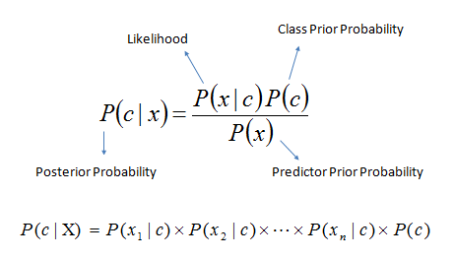

Slide 11
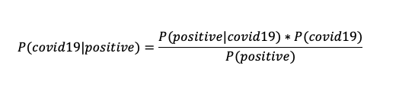


As you know, Covid-19 tests are common nowadays, but some results of tests are not true. Let’s assume; a diagnostic test has 99% accuracy and 60% of all people have Covid-19. If a patient tests positive, what is the probability that they actually have the disease?
P(positive|covid19) = 0.99
P(covid19) = 0.6
P(positive) = 0.6*0.99+0.4*0.01=0.598

Slide 12
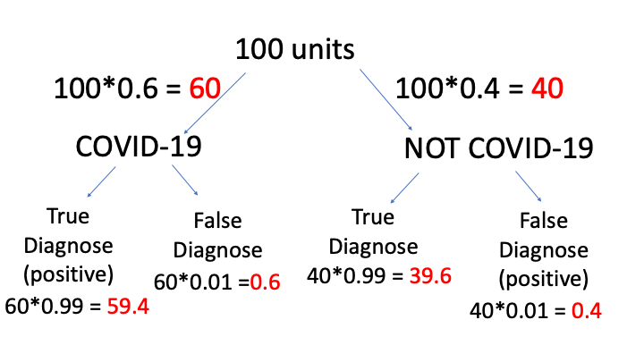

Slide 13
Let’s work on a simple NLP problem with Bayes Theorem. By using NLP, I can detect spam e-mails in my inbox. Assume that the word ‘offer’ occurs in 80% of the spam messages in my account. Also, let’s assume ‘offer’ occurs in 10% of my desired e-mails. If 30% of the received e-mails are considered as a scam, and I will receive a new message which contains ‘offer’, what is the probability that it is spam?

Slide 14
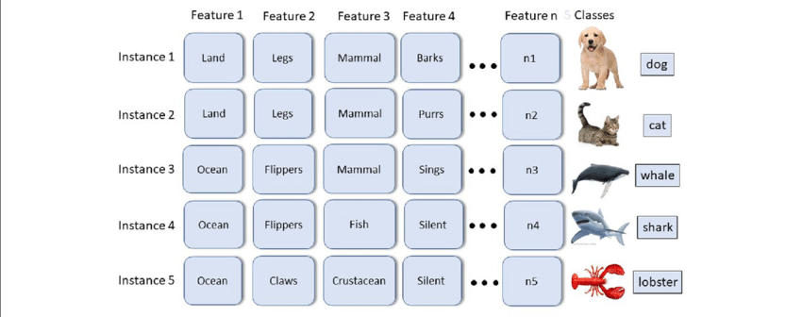
NAÏVE BAYES
Naive Bayes is a machine learning algorithm used to solve classification problems.

Slide 15

NAÏVE BAYES
Naive Bayes uses the Bayes’ Theorem and assumes that all predictors are independent. In other words, this classifier assumes that the presence of one particular feature in a class doesn’t affect the presence of another one.
Round
Contribute independently to assumption
“Naïve”
Orange
3.5 inches

Slide 16

Naïve Bayes Formula
P(y | x1, …, xn) = [P(x1 | y) P(x2 | y) … P(xn | y) P(y)]/[P(x1) P (x2) … P(xn)]

Slide 17
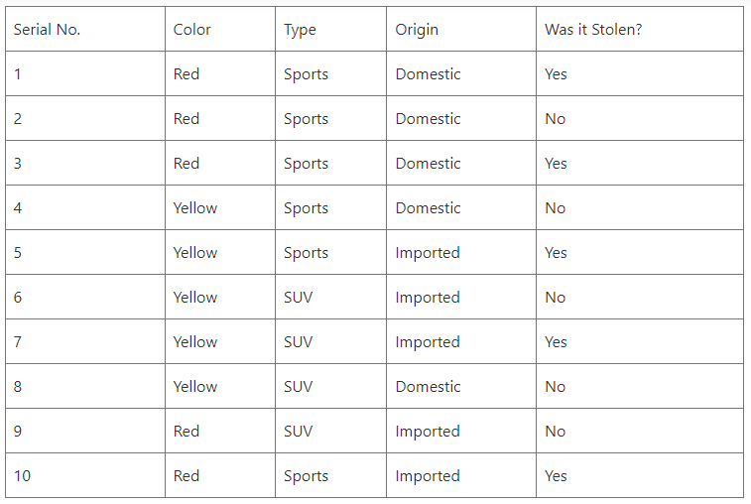
Suppose we want to find stolen cars and have the following dataset:
{Red, Domestic, SUV}

Slide 18
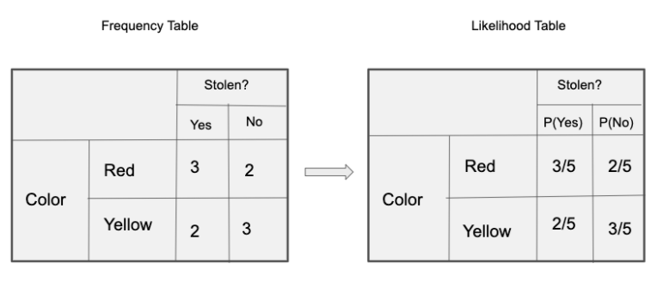
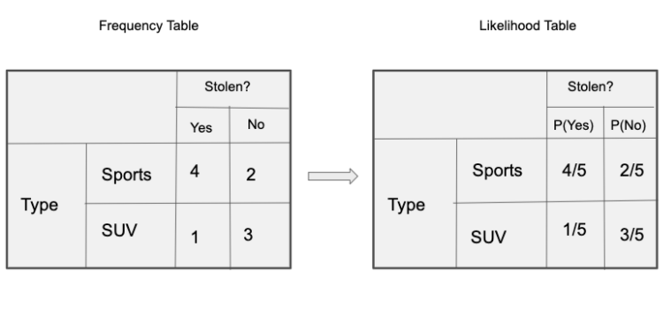
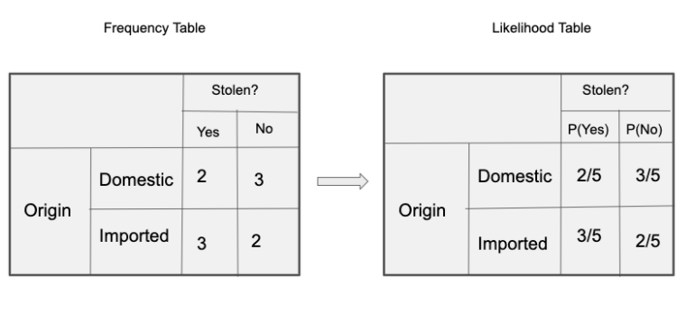

Slide 19
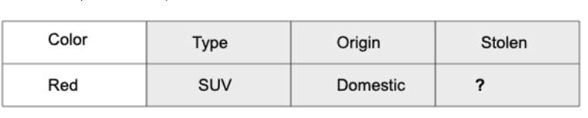
X = (Red, SUV, Domestic)
P(Yes|X) = P(Red|Yes) * P(SUV|Yes) * P(Domestic|Yes) * P(Yes)
P(No|X) = P(Red|No)*P(SUV|No)*P(Domestic|No) * P(No)
P(Yes|X) = 3/5*1/5*2/5*0.5 = 0.024
P(No|X) = 2/5*3/5*3/5*0.5 = 0.072
{Red, Domestic, SUV} = NO

Slide 20
Advantages
This algorithm works quickly and can save a lot of time.
Naive Bayes is suitable for solving multi-class prediction problems.
Naive Bayes is better suited for categorical input variables than numerical variables.
Disadvantages
Naive Bayes assumes that all predictors (or features) are independent, rarely happening in real life. This limits the applicability of this algorithm in real-world use cases.
This algorithm faces the ‘zero-frequency problem’ where it assigns zero probability to a categorical variable whose category in the test data set wasn’t available in the training dataset. It would be best if you used a smoothing technique to overcome this issue.

Slide 21
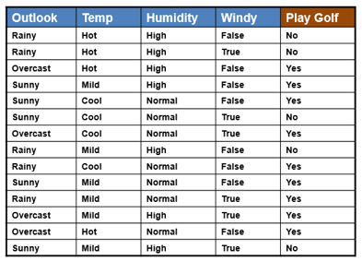

Slide 22
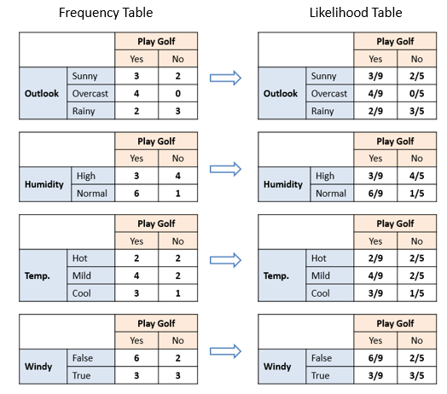
<Outlook=sunny, Temperature = cool, Humidity = high, Wind = Strong>

Slide 23
Types of Naïve Bayes Classifiers
1. Multinomial Naïve Bayes Classifier
Feature vectors represent the frequencies with which certain events have been generated by a multinomial distribution. This is the event model typically used for document classification.
2. Bernoulli Naïve Bayes Classifier:
In the multivariate Bernoulli event model, features are independent booleans (binary variables) describing inputs. Like the multinomial model, this model is popular for document classification tasks, where binary term occurrence (i.e. a word occurs in a document or not) features are used rather than term frequencies (i.e. frequency of a word in the document).
3. Gaussian Naïve Bayes Classifier:
In Gaussian Naïve Bayes, continuous values associated with each feature are assumed to be distributed according to a Gaussian distribution (Normal distribution). When plotted, it gives a bell-shaped curve which is symmetric about the mean of the feature values as shown below:

Slide 24



